Slide 1



EduCore
All-in-One School
Management SaaS
From school operations to parent engagement, billing, support, and digital learning — one secure, multi-tenant platform.
Production Deployment Candidate · Managed-Pilot Ready
Mazen Mekdad
mazenkm96@gmail.com
EduCore | Confidential — Investor Materials
1
Notes:
Welcome. EduCore is an all-in-one school management SaaS platform. In one sentence: it's the operating system a school runs on — admin, teaching, parents, students, billing, support and learning, on one secure multi-tenant platform. Be honest up front about status: this is a Production Deployment Candidate, ready for managed pilots — not a public-production claim. Keep this slide up while you introduce yourself.

Slide 2





THE PROBLEM
Schools run on disconnected, manual systems
Fragmented tooling
Parents in the dark
Attendance, grades, finance, and communication live in separate apps and spreadsheets that don't talk to each other.
Families lack real-time visibility into attendance, grades, fees, and school communication.
Manual admin load
Wrong-fit software
Office teams re-key data across systems — slow, error-prone, and impossible to audit.
Existing systems are too basic, too expensive, or not localized for GCC / bilingual school needs.
EduCore | Confidential — Investor Materials
2
Notes:
Schools today run on a patchwork: a SIS here, spreadsheets for finance, WhatsApp for parents, a separate LMS. Nothing is connected, so staff re-key data by hand and nobody has a single source of truth. Parents are left in the dark on attendance, grades and fees. And the software that does exist is usually too basic, too expensive, or simply not built for GCC bilingual schools. This is the pain we remove.

Slide 3




THE OPPORTUNITY
Private & international schools are going digital
School leadership increasingly expects cloud-ready, bilingual, secure platforms — with parent engagement, automation, and operational analytics as core requirements, not add-ons.
GCC-first fit
Bilingual Arabic / English, RTL-native, and built around private-school operating models.
Why now
Engagement demand
Digital transformation budgets are shifting from one-off tools to integrated platforms.
Parent apps, real-time notifications, and self-service portals are now baseline expectations.
Parents expect a consumer-grade mobile experience from their child's school.
Automation pull
Schools want to cut manual admin: billing, attendance alerts, reporting, and onboarding.
Schools prefer a single accountable vendor over stitching five point solutions.
Trust & data control
Tenant isolation, audit trails, and consent management are rising procurement criteria.
Market sizing intentionally omitted — to be supported by sourced data in diligence.
EduCore | Confidential — Investor Materials
3
Notes:
The shift is structural: schools are moving budget from one-off tools to integrated platforms, and parents now expect a consumer-grade mobile experience. GCC and international private schools specifically need bilingual, RTL-native, secure, cloud-ready systems. I've deliberately NOT invented a market size number here — that belongs in diligence with sourced data. The point is the timing and the fit.

Slide 4










THE SOLUTION
One operating system for the whole school
One secure, multi-tenant platform serving every stakeholder — and the front desk.
School Admin
Super Admin
Staff
EduCore
Platform Core
Teacher
Student
Parent
Kiosk
Mobile App
EduCore | Confidential — Investor Materials
4
Notes:
EduCore is one platform for every stakeholder. The core sits in the middle; around it are the six role-based portals plus the mobile app and the kiosk. One login model, one data layer, one accountable vendor. That's the whole pitch in a picture: instead of stitching five tools, the school runs on EduCore.

Slide 5















PRODUCT
A complete module map — built, not promised
Student Records (SIS)
Attendance
Timetable
Gradebook
LMS & Courses
Assignments
Finance & Invoices
Parent Payments
CRM & Admissions
Support / Helpdesk
Notifications
Legal & Consent
Kiosk Attendance
Mobile App
Reports & Analytics
Tenant & Subscriptions
16 functional modules implemented across backend, web, and data layers.
EduCore | Confidential — Investor Materials
5
Notes:
This is what's actually built — not a wish list. Sixteen functional modules spanning student records, attendance, timetable, gradebook, LMS, assignments, finance and parent payments, CRM and admissions, support, notifications, legal and consent, kiosk attendance, the mobile app, reporting, and tenant/subscription management. Each of these is wired across the backend, the web app and the data layer.

Slide 6






EXPERIENCES
Six role-based portals + mobile & kiosk
Super Admin
School Admin
Staff
Manage every school tenant, plans, subscriptions, announcements & audit logs.
Run the whole school: students, staff, finance, academics & settings.
Front-desk & operations access scoped to day-to-day duties.
Teacher
Parent
Student
Attendance, gradebook, assignments, classes & messaging.
Real-time visibility into each child, fees, payments & messages.
Schedule, assignments, grades, courses & announcements.
Flutter Mobile App
Flutter Kiosk (QR attendance)
EduCore | Confidential — Investor Materials
6
Notes:
Access is role-based. Super Admin operates the whole platform across school tenants. School Admin runs one school end to end. Staff get scoped front-desk access. Teachers get attendance, gradebook and assignments. Parents get real-time visibility per child plus fees and messaging. Students get their schedule, assignments and grades. On top, the Flutter mobile app and the kiosk for QR attendance.

Slide 7
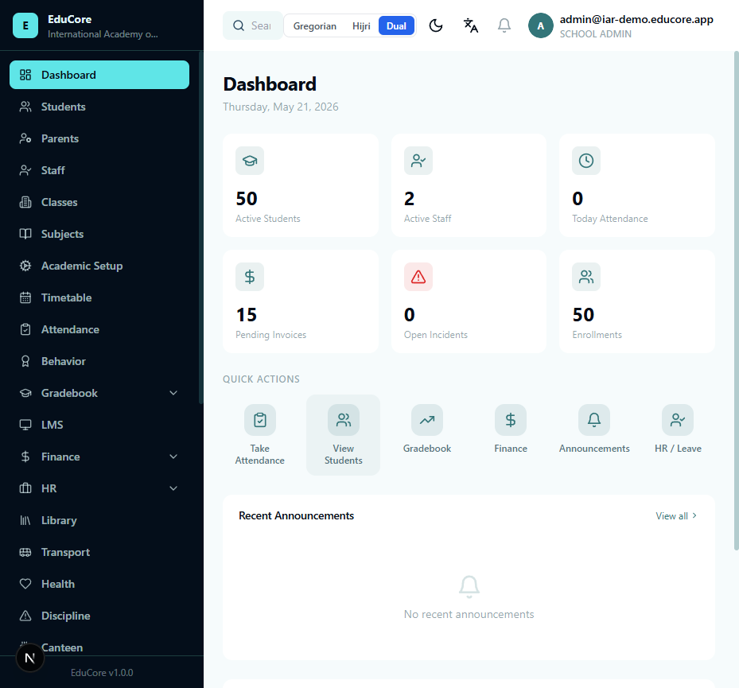
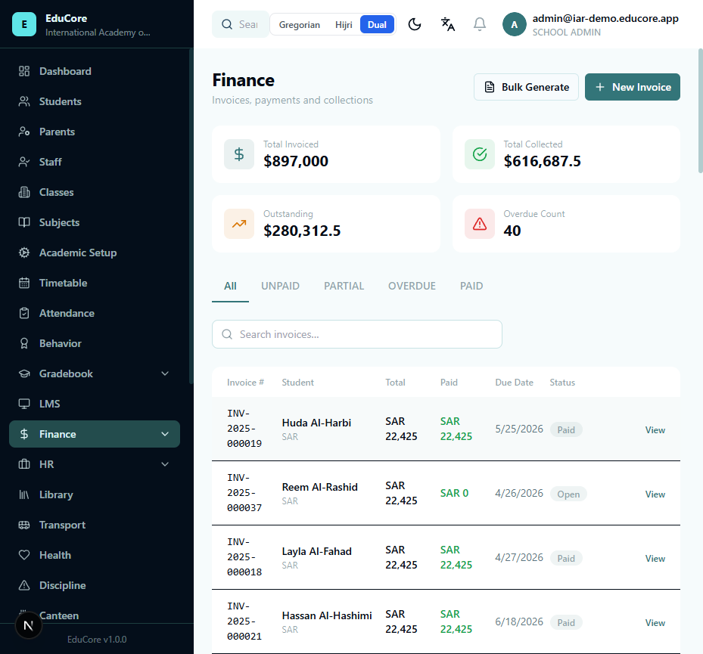
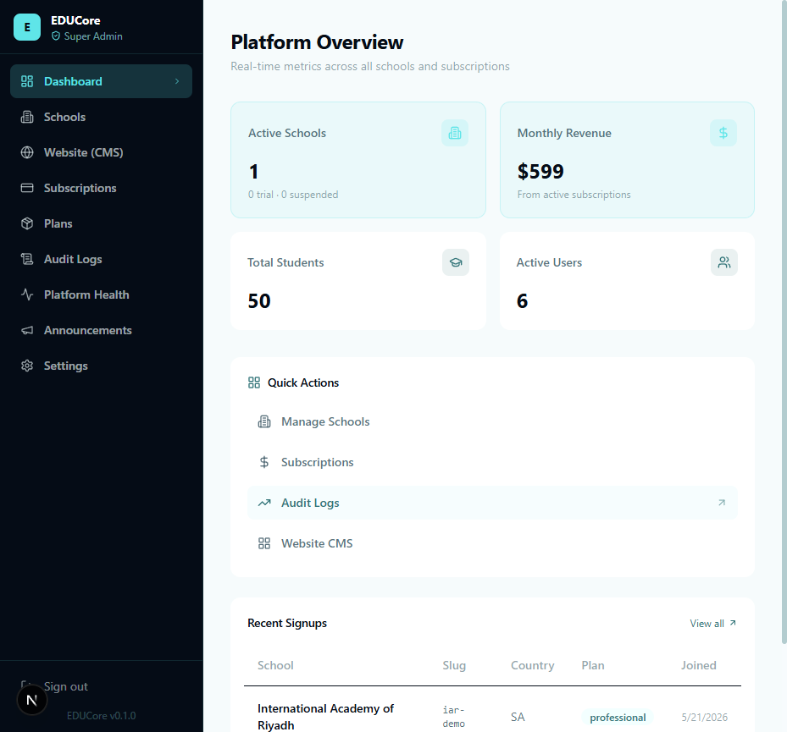
PRODUCT DEMO
Real screens from the working build
School Admin · Dashboard
Finance · Billing
Super Admin · Platform
Operational dashboards
Invoicing & payments
Multi-tenant control
Captured from the local environment — additional portal screens available in the live demo.
EduCore | Confidential — Investor Materials
7
Notes:
These are real screenshots from the working build, not mockups: the School Admin dashboard, the finance and billing view, and the Super Admin multi-tenant console. In a live demo I can walk through any portal end to end. The message: the product exists and runs today.

Slide 8

WHY EDUCORE
All-in-one — where others are point tools
Capability
EduCore
Typical school system
All-in-one SaaS suite
Single platform across SIS, finance, LMS & comms
Separate apps stitched together
Multi-tenant by design
EF global tenant isolation at the data layer
Single-school or bolt-on tenancy
Built-in CRM + demo booking
Lead capture → admissions pipeline included
Requires external CRM
Support & helpdesk
Ticketing with SLAs inside the platform
Email / third-party desk
Legal, consent & privacy
Consent records & data-request workflows
Rarely addressed
GCC-ready & bilingual
Arabic/English, RTL-native, ZATCA-aware finance
English-first, localized later
EduCore | Confidential — Investor Materials
8
Notes:
Where typical school systems are point tools stitched together, EduCore is all-in-one. Multi-tenant isolation is enforced at the data layer, not bolted on. CRM and demo booking are built in. Support, legal/consent, and bilingual GCC-ready finance ship as part of the platform. That breadth — with production operations scripts and security-first tenant isolation — is the differentiation.

Slide 9









TECHNOLOGY
Modern, cloud-ready architecture
CLIENTS
Web App
Marketing
Mobile
Kiosk
Next.js 15
Next.js
Flutter
Flutter
APPLICATION
.NET 8 REST API
Security Layer
Auth · RBAC · tenant isolation · business logic
JWT · EF global query filters · audit logging
DATA & INTEGRATIONS
PostgreSQL
Redis
MinIO / S3
Stripe
Email·SMS·FCM
Monitoring
EF Core
cache
storage
billing
notify
Sentry-ready
Containerized with Docker Compose · deployable to Hostinger VPS · reverse proxy with automatic HTTPS.
EduCore | Confidential — Investor Materials
9
Notes:
Investor-friendly view of the stack. Clients — web, marketing, mobile, kiosk — talk to a single .NET 8 API that enforces auth, role-based access and tenant isolation. Behind it: PostgreSQL via EF Core, Redis, MinIO/S3 storage, plus Stripe, email/SMS/push and monitoring. Everything is containerized with Docker Compose and deployable to a Hostinger VPS with automatic HTTPS. Modern, boring-in-a-good-way, and cloud-ready.

Slide 10







SECURITY & COMPLIANCE
Designed for compliance readiness
Tenant isolation
Role-based access
EF Core global query filters enforce per-tenant data boundaries automatically.
Granular RBAC keeps parent, student, teacher & admin boundaries separate.
Audit logging
Consent & data requests
Sensitive admin actions are recorded with correlation IDs for traceability.
Consent records and data-request workflows scaffolded into the platform.
Legal pages
Backup & monitoring
Versioned legal documents, acceptance tracking & retention policies.
Backup/restore/rollback scripts and Sentry-ready error tracking.
Designed to support compliance readiness. No ISO / SOC 2 / GDPR certification is claimed — legal review is required before public launch.
EduCore | Confidential — Investor Materials
10
Notes:
Security is designed in. Tenant isolation uses EF Core global query filters so data boundaries are enforced automatically. Role-based access keeps parent/student/teacher/admin separate. Sensitive actions are audit-logged with correlation IDs. Consent records and data-request workflows are scaffolded, with versioned legal documents and retention policies. Be explicit and honest: we are DESIGNED for compliance readiness — we claim no ISO/SOC 2/GDPR certification, and legal review is required before public launch.

Slide 11

BUSINESS MODEL
Recurring SaaS revenue per school
MOST POPULAR
Core
Professional
Enterprise / Group
Essential operations
Most popular
Multi-school
SIS & attendance
Everything in Core
Everything in Pro
Gradebook & timetable
Finance & payments
Multi-school management
Parent & student portals
LMS & assignments
Advanced analytics
Notifications
Support & CRM
White-label (future)
Revenue levers: per-school subscription · per-student pricing option · setup & onboarding fee · premium modules · SMS/payment transaction fees · enterprise white-label (future)
EduCore | Confidential — Investor Materials
11
Notes:
Recurring SaaS revenue per school, in three tiers — Core, Professional, and Enterprise/Group. Beyond the subscription, we have multiple levers: a per-student pricing option, setup and onboarding fees, premium modules, transaction fees on SMS and payments, and a future white-label/enterprise path for school groups.

Slide 12




GO-TO-MARKET
Land with pilots, expand to groups
1 · Managed pilots
2 · Core bundle
3 · GCC-first
4 · Expand & upsell
Start with hands-on, white-glove pilots at small-to-mid private & international schools.
Sell SIS + attendance + finance + parent comms + support as the wedge.
Win on bilingual, RTL-native, GCC-aligned operations & finance.
Grow into multi-school groups; upsell LMS, CRM, analytics & premium modules.
Beachhead → repeatable bundle → regional focus → multi-school expansion
EduCore | Confidential — Investor Materials
12
Notes:
Go-to-market is land-and-expand. We start with hands-on managed pilots at small-to-mid private and international schools. The wedge bundle is SIS plus attendance plus finance plus parent communication plus support. We win GCC-first on bilingual and localized fit. Then we expand into multi-school groups and upsell LMS, CRM and analytics.

Slide 13
READINESS & TRACTION
Engineering proof, not slideware
207
61
52
16
Backend tests passing
Web tests passing
API controllers
Modules built
Code readiness
~98%
Deployment readiness
~90%
Shipped: CRM · Notifications (FCM v1) · Support/Helpdesk · Legal & Privacy · Tenant isolation · Stripe webhook hardening · Backup/Restore/Rollback · Monitoring-ready
Status: Production Deployment Candidate — automated gates green; manual production gates pending.
EduCore | Confidential — Investor Materials
13
Notes:
This is the proof. 207 backend tests and 61 web tests passing; 52 API controllers; 16 modules built. Code readiness is roughly 98%, deployment readiness roughly 90%. We've shipped CRM, notifications with FCM v1, support/helpdesk, legal and privacy, hardened tenant isolation, Stripe webhook signature and idempotency, plus backup/restore/rollback and monitoring readiness. Status stays honest: Production Deployment Candidate — automated gates are green, manual production gates remain.

Slide 14




ROADMAP TO LAUNCH
From candidate to live in 30 / 60 / 90 days
First 30 days
60 days
90 days
Final code gaps closed
Legal & privacy sign-off
First paid pilot live
Hostinger VPS deployment
Backup/restore rehearsal on real DB
Mobile & kiosk real-device QA
Live provider credentials (email/SMS/push)
Security review & hardening
Onboarding playbook refined
Stripe live verification
UAT with pilot school
Public launch approval
EduCore | Confidential — Investor Materials
14
Notes:
A concrete 30/60/90 path. First 30 days: close final code gaps, deploy to Hostinger, wire live providers, verify Stripe live. By 60 days: legal sign-off, backup/restore rehearsal on a real database, security review, UAT with a pilot school. By 90 days: first paid pilot live, mobile and kiosk real-device QA, and public launch approval. These are the exact manual gates between candidate and live.

Slide 15








FUTURE ADVANTAGE
EduCore AI — the data moat ahead
EduCore's unified data across attendance, grades, finance & engagement creates a foundation for predictive intelligence — a roadmap layer, not a current feature.
At-risk student prediction
Attendance risk alerts
Fee-collection forecasting
Teacher workload insights
Parent engagement score
School health score
AI-generated school reports
Leadership recommendations
Roadmap / future modules — shown for vision. Not live features today.
EduCore | Confidential — Investor Materials
15
Notes:
The forward-looking moat. Because EduCore unifies attendance, grades, finance and engagement data, it's positioned to add predictive intelligence: at-risk student prediction, attendance risk, fee-collection forecasting, workload and engagement scores, a school health score, AI-generated reports and leadership recommendations. Be clear: this is roadmap and vision — not a live feature today.

Slide 16

ILLUSTRATIVE MODEL
Unit economics & ARR scenario
$4
per student / month
blended ARPU (assumption)
Illustrative ARR by stage (assumptions, not forecasts)
500
students / school
average (assumption)
$24K
ARR per school
500 × $4 × 12
+ $2.5K
setup fee / school
one-time onboarding
Assumptions illustrative only — not actual or projected revenue. No live customers or bookings are claimed. See pitch-data-assumptions.md.
EduCore | Confidential — Investor Materials
16
Notes:
An illustrative model — clearly labeled as assumptions, not actuals or forecasts. Example: a blended four-dollar per-student per-month ARPU, 500 students per school, gives about $24K ARR per school plus a one-time setup fee. Scaling schools from roughly 10 to 35 to 100 across three years illustrates the ARR shape. I want to be explicit: we have no live customers or bookings to claim — these are planning assumptions, detailed in pitch-data-assumptions.md.

Slide 17
THE ASK
Investment to move from build to market
Use of funds (illustrative allocation)
Raising
$ [ amount ]
Seed round · target amount to be confirmed
Milestones after funding
Launch first managed pilots
Onboard initial schools
Convert pilots to paid subscriptions
Expand modules & multi-school groups
EduCore | Confidential — Investor Materials
17
Notes:
The ask. We're raising a seed round — the amount is a placeholder to confirm with you. Use of funds, illustratively: product finalization and QA, sales and onboarding, cloud and infrastructure, customer support, mobile and kiosk release, and compliance/legal. The milestones that money buys: launch pilots, onboard the first schools, convert them to paid subscriptions, and expand modules and multi-school groups.

Slide 18

EduCore
Ready to move from
product build to market launch.
A complete digital operating system for modern schools.
Mazen Mekdad
mazenkm96@gmail.com
Production Deployment Candidate · Managed-Pilot Ready
EduCore | Confidential — Investor Materials
18
Notes:
To close: EduCore is ready to move from product build to market launch. It's a complete digital operating system for modern schools, engineered and tested, sitting at the deployment-candidate line with a clear 90-day path to live. I'd love to partner on taking it to the first schools. My contact is on screen — let's talk.

